Slide 1
Employee Performance Analysis Using Excel
PRESENTED BY: Monisha B
REGISTER NO : 312204593
DEPARTMENT : COMMERCE
COLLEGE : K.C.S KASI NADAR COLLEGE OF ARTS AND SCIENCE

Slide 2
PROJECT TITLE
Employee Performance Analysis Using Excel

Slide 3
AGENDA
1.Problem Statement
2. Project Overview
3.End Users
4.Our Solution and Proposition
5. Dataset Description
6. Modelling Approach
7. Results and Discussion
8.Conclusion

Slide 4
PROBLEM STATEMENT
Categorization Accuracy:
Verify that employee IDs are accurately categorized into 'Fully Meets' or 'Needs Improvement' categories.
Ensure that the grand total of all employee IDs (34,815) accurately reflects the sum of IDs in the categorized columns and that there are no discrepancies.
Data Completeness:
Examine any blank entries to confirm that no employee data is missing or incorrectly unassigned.
Evaluate the extent to which employee IDs are distributed across the two performance categories, and identify if there are any gaps in the data.
Performance Distribution:
Analyze the proportion of employee IDs in each performance category to understand the overall distribution of employee performance.
Identify any trends or patterns in the data that may indicate areas of strength or concern within the workforce.

Slide 5
PROJECT OVERVIEW
[Employee Performance Improvement and Pay Zone Optimization]
Accuracy and completeness
Performance and Distribution analysis
Reporting and Recommendations
Data gaps and follow-up

Slide 6
WHO ARE THE END USERS?
Human Resources (HR) Department
Department Managers (Sales & Production)
Senior Leadership/Executives
Employees

Slide 7
OUR SOLUTION AND ITS VALUE PROPOSITION
Filtering - Remove missing values.
Conditional Formatting - Blanks, Background Color Shading, Data Bars, Values.
Data Filtering and Sorting - Identify specific employee groups, such as those with exceeds, needs improvements and fully meets.
Pivot table - Summary of employee performance under their current rating .
Graphs - FINAL REPORT.

Slide 8
DATASET DESCRIPTION
EMPLOYEE ID: Unique identifier for each employee in the organization.
FIRST NAME: The first name of the employee.
Performance Score: A score indicating the employee's performance level (e.g., Excellent, Satisfactory, Needs Improvement).

Slide 9
MODELLING
DATA SET: Kaggle, Employee dataset.
FEATURE SELECTION: Slicer, Conditional Formatting, Designing.
DATA CLEANING: Missing values, Irrelevant data, Correct Errors, Remove Unnecessary Columns and Rows.
PIVOT TABLE: Employee ID, First Name, Pay zone, Department Type, Current Employee Rating.
CHART: Report of Employee Performance based on their Employee Id is represent in Values and Performance Score presented as Column Chart..

Slide 10

RESULTS

Slide 11

CONCLUSION
Distribution of Employee Performance:
The majority of employee IDs (27,856) are categorized under "Fully Meets," indicating a positive performance trend.
A smaller subset of IDs (6,959) falls under "Needs Improvement," which is significantly less compared to those categorized as "Fully Meets."
Data Integrity:
The grand total of all employee IDs (34,815) aligns with the sum of the categorized IDs, suggesting accurate data aggregation.
Performance Insights:
The data suggests that most employees are performing at an acceptable level ("Fully Meets"), while a smaller portion requires improvement.
This distribution indicates a generally strong performance across the workforce, but it also highlights a segment that might need additional support or intervention.

Slide 12
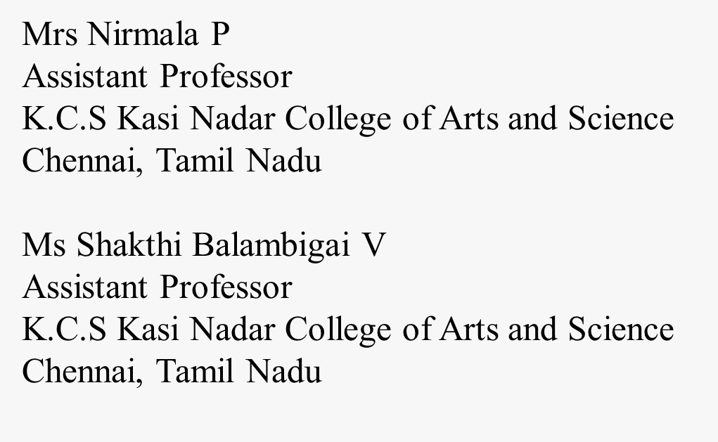
REFERENCE

